Slide 1
SonarQube Scanner For Maven

Slide 2
Prerequisites
SonarQube
Java
Maven
The language plugins for each of the languages you wish to analyze are installed

Slide 3
Compatibility
From maven-sonar-plugin 3.4.0.905, SonarQube < 5.6 is no longer supported.
If using SonarQube instance prior to 5.6, you should use maven-sonar-plugin 3.3.0.603.
From maven-sonar-plugin 3.1, Maven < 3.0 is no longer supported.
If using Maven prior to 3.0, you should use maven-sonar-plugin 3.0.2.
Maven 2.x not supported

Slide 4
Configuration In Maven (Settings.xml)
<pluginGroups>
<pluginGroup>org.sonarsource.scanner.maven</pluginGroup>
</pluginGroups>
</profiles>
<profile>
<id>sonar</id>
<activation> <activeByDefault>true</activeByDefault>
</activation>
<properties>
<sonar.host.url>http://localhost:9000</sonar.host.url> </properties>
</profile>
</profiles>
Notes:
<pluginGroup>org.sonarsource.scanner.maven</pluginGroup>
This plugin will download sonarscanner for maven and it will take care of running project
Profiles:::::
id – optional
activationBYDefault - true
Sonar.host.url - Provide local or global Url of sonarqube

Slide 5
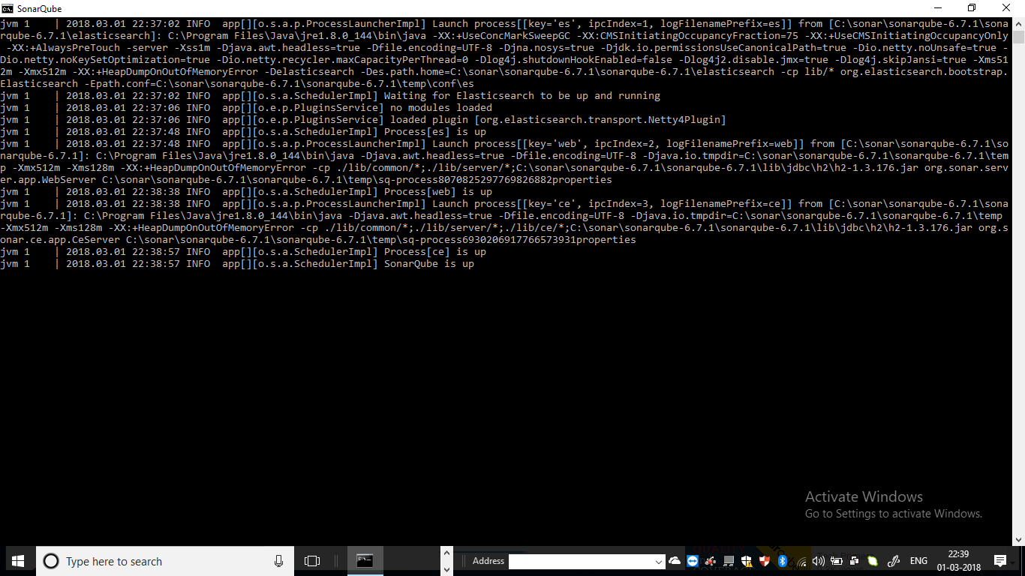
SonarQube Server Up
Navigate to
sonarqube-6.7.1/bin/windows-x86-64/
Click on “StartSonar” bat file to make “SonaQube Server” up

Slide 6
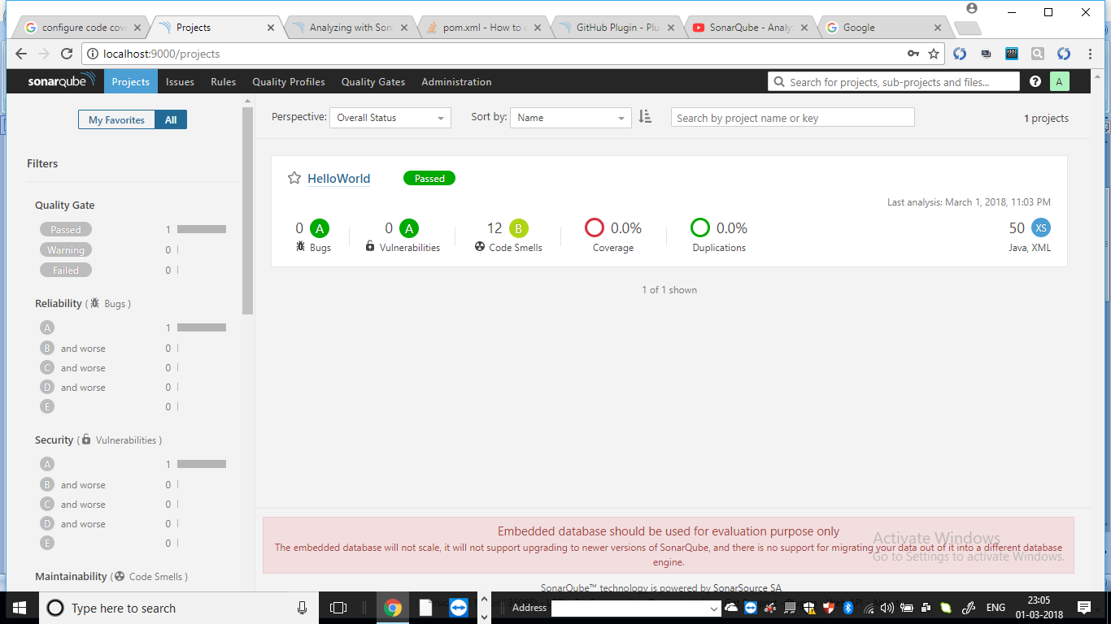
Run And Check Results
Navigate to pom.xml which is present in Maven Project
Open the Command Prompt(CMD) from pom.xml location
Execute below commads:
mvn clean verify sonar:sonar
mvn sonar:sonar
After excecuting above commands successfully navigate host of sonarqube to check the results (You will get result as below mentioned Snap)

